Slide 1


Supply Chain of Covid19 Vaccination Process Based On Blockchain
INTERNATIONAL BLOCKCHAIN OLYMPIAD(BCOLBD 2021)

Slide 2

Team Information
[Daffodil International University] [CSE]﻿ ﻿[ Md. Sabbir Alam Pran]
[Military Institute of Science and Technology] [IPE][ Mohammad Nazmus Shakib]
Team Name: nonceMiner
Team ID : 6003331215762

Slide 3
Information
Product
Funds
Supply Chain is the movement of
Notes:
We are focusting on responsiveness.
Information Biggest driver
Accurate,
Accessible
Right kind
VIsibility

Slide 4
A continuous updated record of who holds what
A shared single source of truth
Blockchain

Slide 5
Do we need Blockchain?
Can a traditional database technology meet our demand?
Should more than one participant be able to update the data?
Do all the updaters trust each other?
Would all the participants trust the third party?
Do we need to keep the data private?
Notes:
Fraud: likely of fraud
Middle Man: if they don’t add value, to reduce cost
Number of transaction: 400 thoudasan of transaction per sec, by 100 laps
Stable data: can’t be changed
There are a few key benefits to decentralizing things instead of keeping it in a centralized server/database:
Immutability
Security
Redundancy
Overhead/cost reduction
Accountability/transparency
avoiding interference from government agencies
robust, fault-tolerant way to store critical data
Overhead/cost reduction
Having a decentralized network of nodes to maintain this ledger allows companies to offset and offload hosting, security, and maintenance costs. It removes a lot of the costs of IT staffing, Dev Ops, and infrastructural overhead.
Other blockchains Implement what are called “Smart Contracts” like on the Ethereum network. These are much like using stored procedures in a database, in which triggers can be used to execute code to process a transaction.

Slide 6
Drug traceability.
Ensure Vaccine Integrity (Tamper-proof, Contamination, Theft)
Authorization power (no other can block, change without access)
Transportation (temperature update)
A need of trust and security (Transection of supplier, order, invoice and shipment)
Prioritization & Allocation (scheduling).
Syndicate, Bottleneck Overview, Expired Stock, Overstocking and Damaged stock
Fully transparent distribution process and safety.
Problem
&
solution
Notes:
smart contract pays the mill
Bullwhip Effect Lead Time Reorder Point Safety Stock Cycle Stock
made so that it cannot be interfered with or changed

Slide 7
Feedback patient data management
Vaccination training
We can find that’s is going on a particular age group, fixed location.
Give motivation to those who don’t believe that vaccine works.
Quality expired vaccine use.
Over head cost less, no charge for transection(frictional cost less)
Prevent fraud and data theft
Future improvement research.
Preparation for next pandemic.
Problem
&
solution
Notes:
, smart contract reaction to the vaccine, medical record, continue of side effect,
Vaccine train korse kina
Like bad vaccination who will take the responsibility?

Slide 8


Market & Partners
Vaccine distribution contract
Shot term:
Our potential buyer is our government
Long term:
Vaccine Manufacturer
Notes:
After using successful implementation, based on our data, we can approach manufacturing company,
As we have said that it is a governernment subside project and have a good future for the upcoming time,
And by all the feedback benefit, Distribution, Testing, Regulation it will be good reason to act as globally,
And also prepair us for the next pandemic, and in this always running for other good rare vaccine.

Slide 9
Initial cost
Energy consumption
Security: 51 percent
Conflict with legacy system
Bug in smart contract
Uncertainty
Risk
Notes:
Bigger block chain users, low risk because
Energy consumption : poofe of stake

Slide 10
Big pharmaceutical company
IT Firm
Competitor
Notes:
Bigger block chain users, low risk because
Energy consumption : poofe of stake

Slide 11
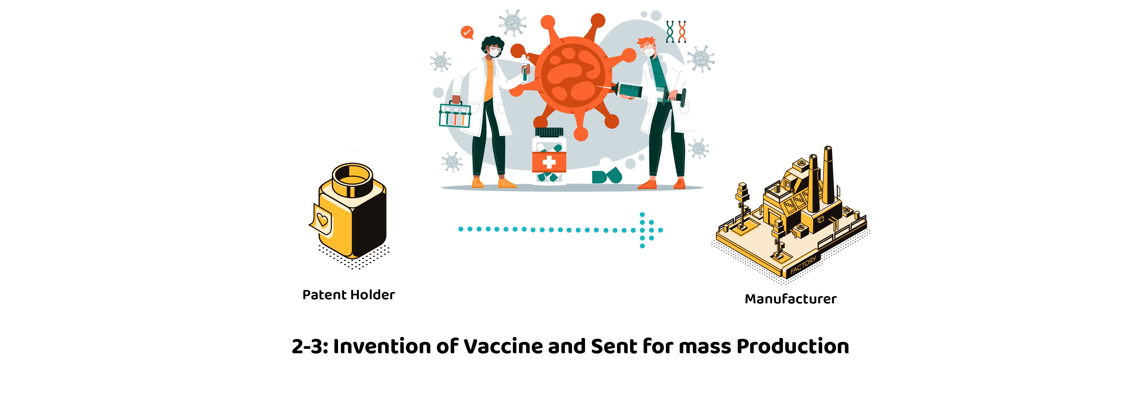
Project Methodology
1:
Organization name
Manufacturing Country
Manufacturing And Expiring date of vaccine
Batch no of each vaccine
Patent holders name
Country
Qualification

Slide 12
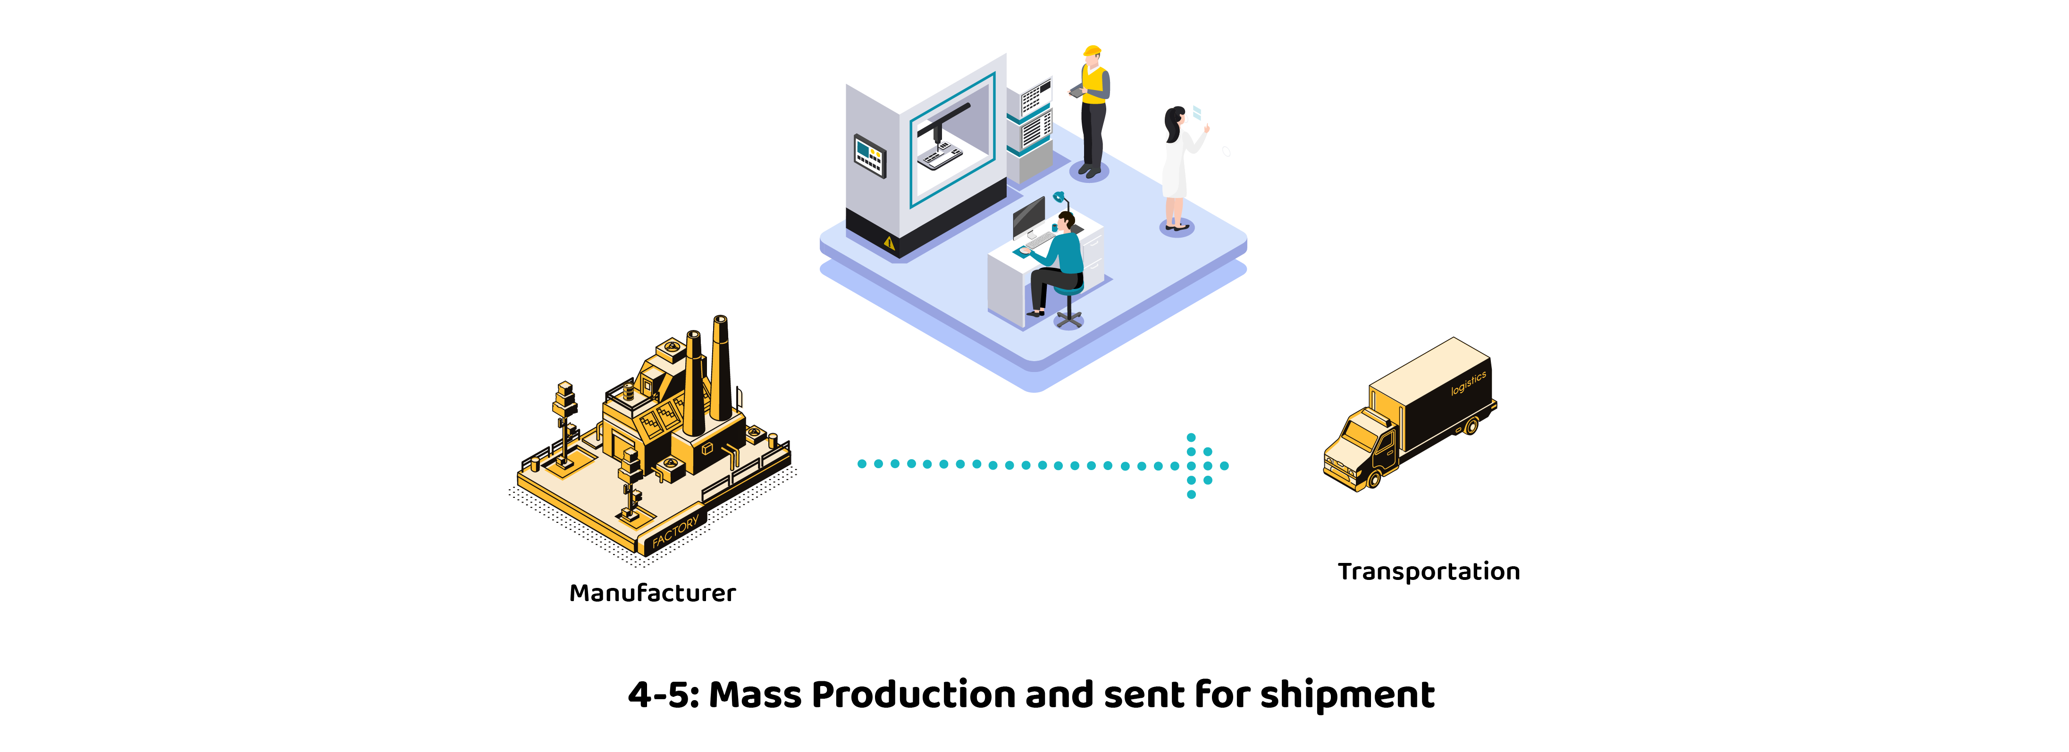
Project Methodology
2:
Hand over date
Shipping company name
Date of hand over
Packing temperature
Quantity of vaccine
Transportation date
Vaccine's temperature(continuously updated)
Tentative delivery date

Slide 13
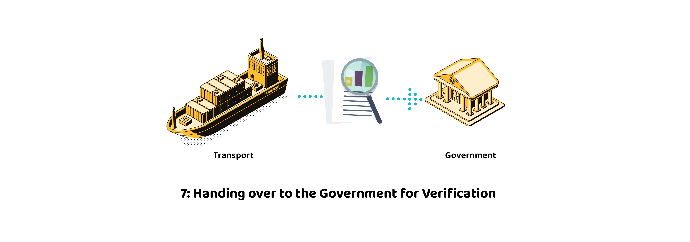
Project Methodology
4:
Accepting vaccine
Checking Quantity
Packing temperature
Received date
Delivery date
Delivered Quantity Check
Temperature check

Slide 14
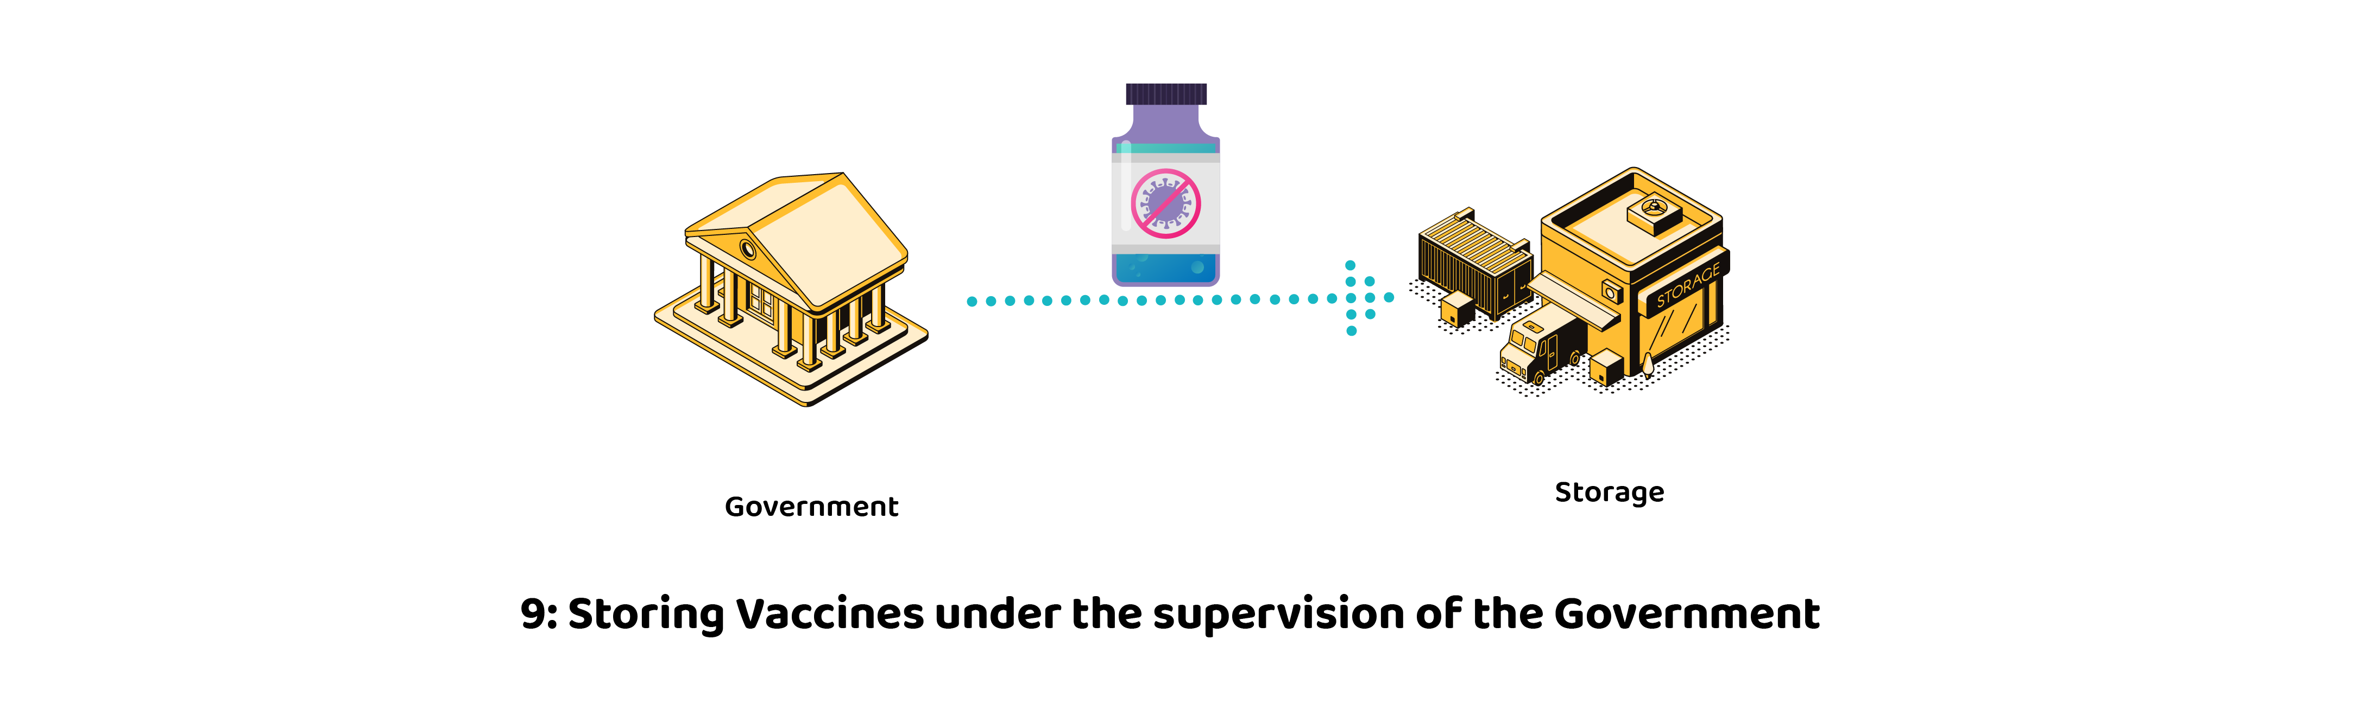
Project Methodology
5:
Storing Date
Shipping company name
Date of hand over
Packing temperature
Quantity of vaccine
Allocating Storage place
Hand over date for storage

Slide 15

Project Methodology
6:
Received Date
Received Quantity
Temperature of vaccine
Received date
Vaccines Quantity
Storing Temperature

Slide 16

Project Methodology
7:
Vaccinators Name
Vaccinators Qualification
Checking Vaccine receivers Priority.
Name of vaccine receiver
Date of vaccinating
Name of Vaccine receiver
Age
Qualification
Address
NID no

Slide 17

Project Methodology
8:
Submit feedback After Receiving(i.e feeling good or bad)

Slide 18

Governance
Authentication of vaccine receiver and vaccine provider to enroll the system.
Verification of the delivered vaccine and confirm the deal.
Setting priority list of vaccine receiver according to their quota.(i.e Freedom Fighter)

Slide 19

Governance
Vaccine Receiver
Giving authentic feedback on vaccination(i.e feeling bad or having any side effect)

Slide 20
Registration
Inputting Vaccine Data
Vaccination Handover
Mass Production
Send for Shipment
Transportation temp update
Vaccine Receiver & Provider Authentication
Prioritization
Vaccination Info
Vaccination Process
Our Implementation

Slide 21
Quota
Freedom Fighters,
Doctors associated with covid treatment,
Nurses,
Frontline staff,
Immune deficient population,
Elderly population(60 up),
Adult population with long term disease,
Education staff,
Public transport worker.

Slide 22
Prototype

Slide 23
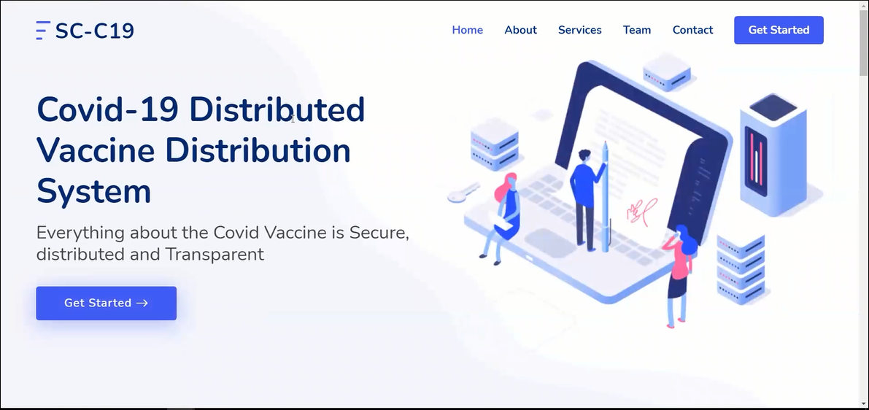

Slide 24
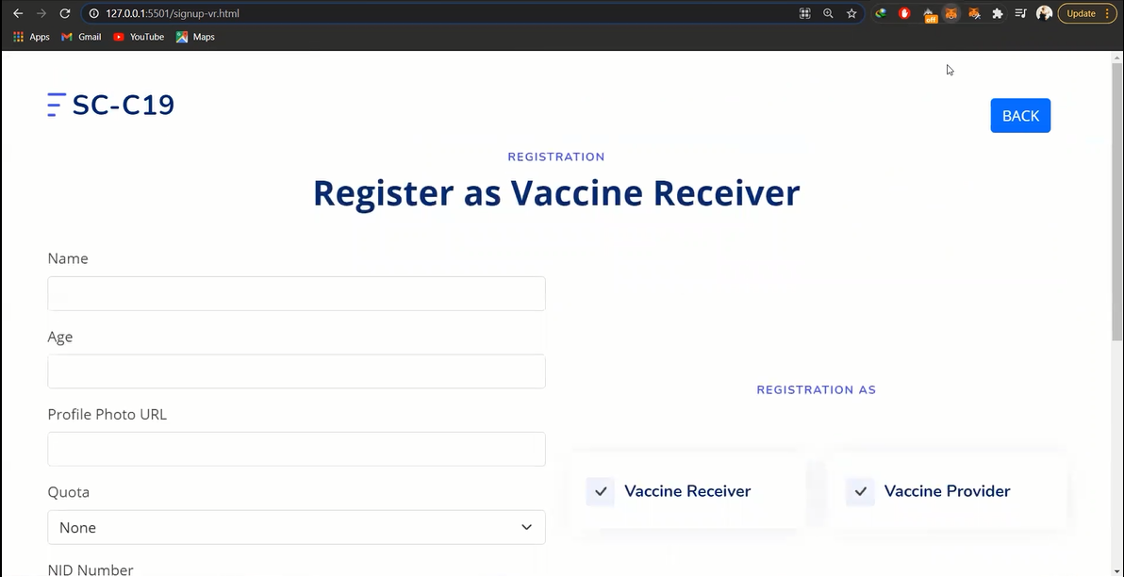

Slide 25
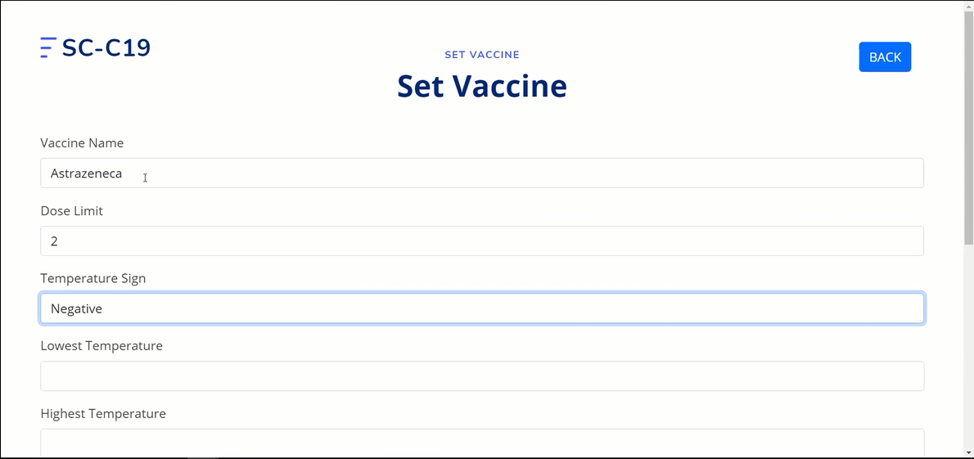

Slide 26
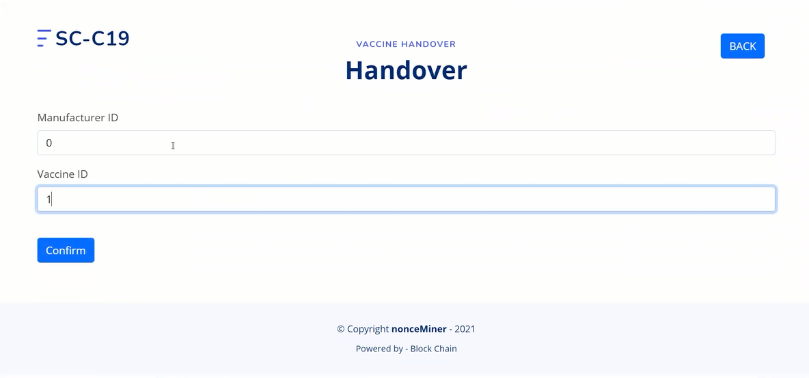

Slide 27
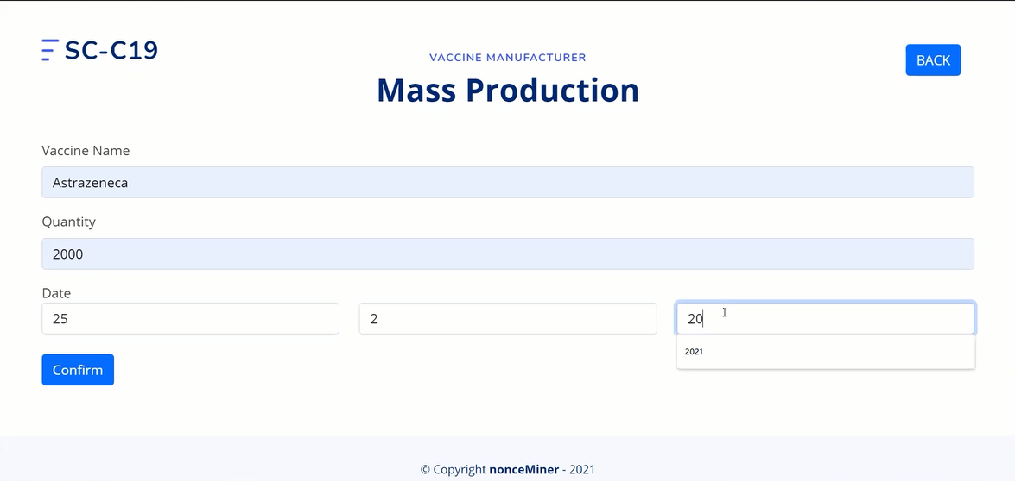

Slide 28
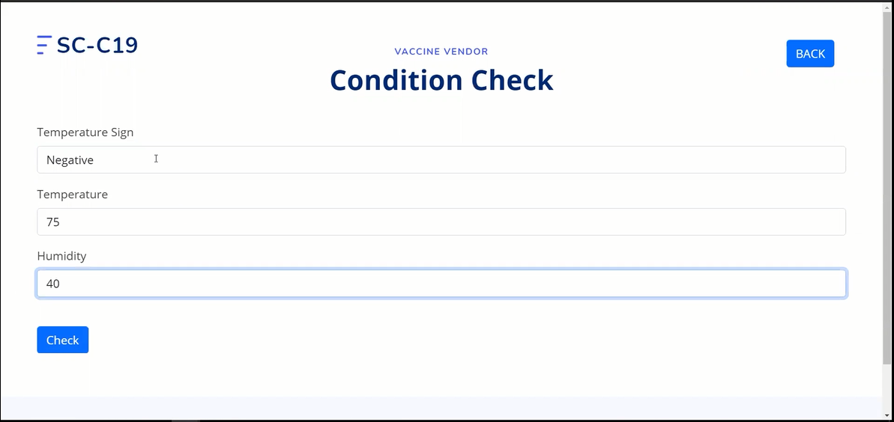

Slide 29
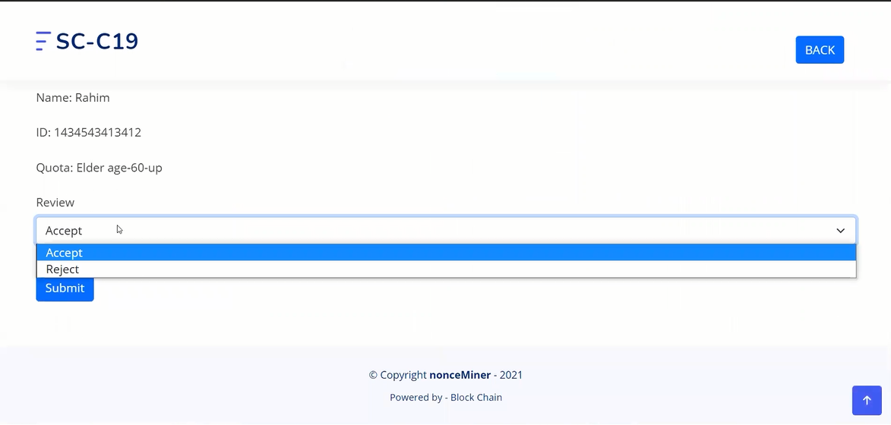

Slide 30
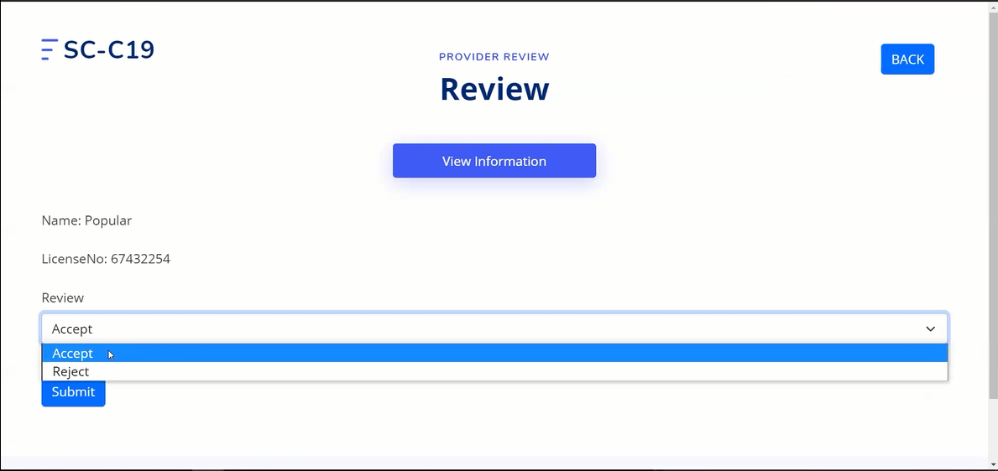

Slide 31
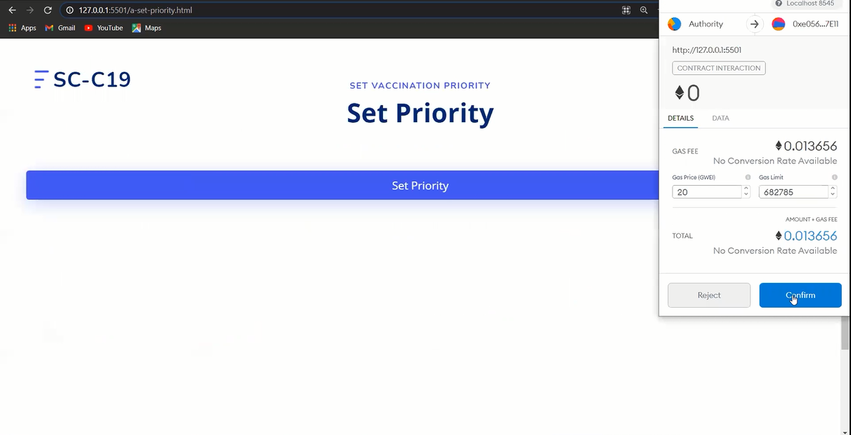

Slide 32
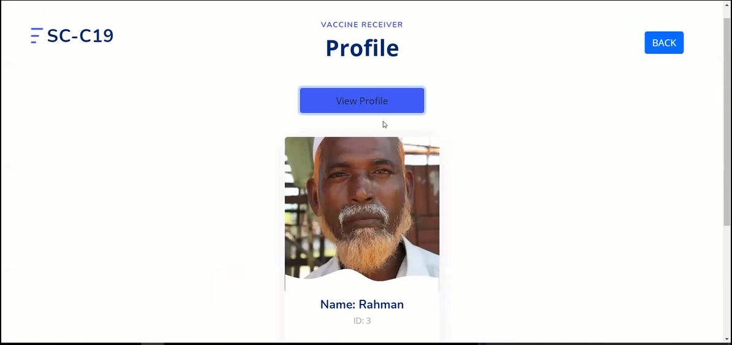

Slide 33
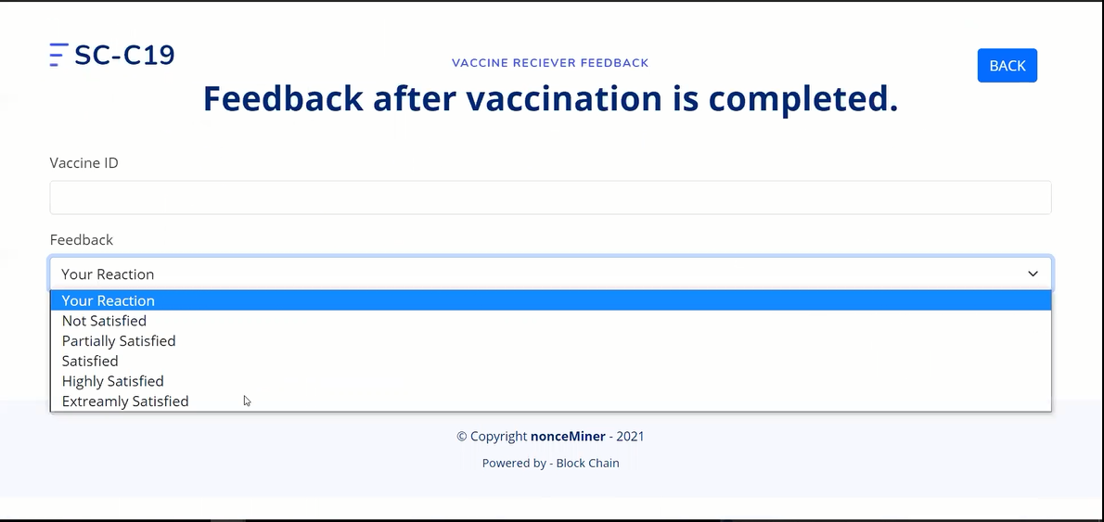

Slide 34
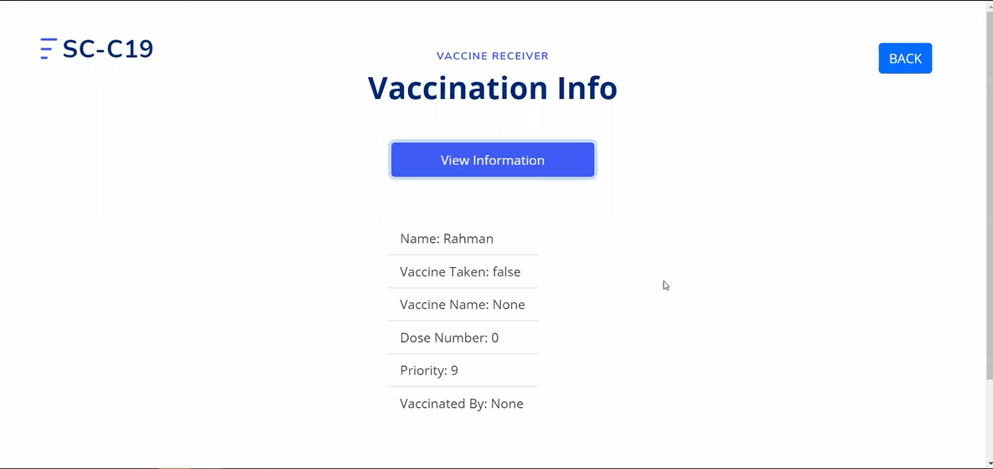

Slide 35
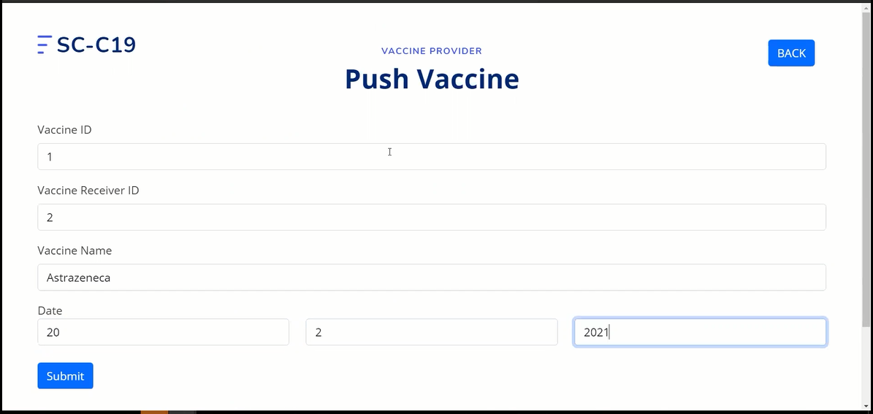

Slide 36
Any Question?

